Slide 1
AI Foundations
02 Workflow of Solution to ML Problems
Week 2

Slide 2
Table of Contents
Recap –eye-distance/Euclidean distance
Overview of Workflow/Pipeline
Practical Application of Workflow using Azure ML
Regression
Classification

Slide 3
Workflow of solution to ML problems
Define business problem
Get data
Pre-process data
Identify suitable ML algorithm
Train algorithm with data to develop a model (Train/test split)
Evaluate the model performance to reach the best performing model.(Retrain & Evaluate)
Deploy application.

Slide 4
Retrain Techniques
Using a different algorithm
Tuning algorithm parameters

Slide 5
Regression – Linear regression
Over-fitting
Automobile price predictor dataset

Slide 6
Regression - Evaluation
Mean Absolute Error (MAE): The average of absolute errors (an error is the difference between the predicted value and the actual value).
Root Mean Squared Error (RMSE): The square root of the average of squared errors of predictions made on the test dataset.

Slide 7
Classification – Decision Tree
Diabetes Prediction

Slide 8
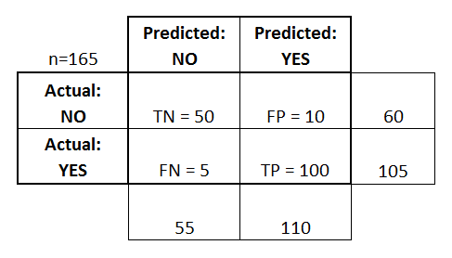
Confusion Matrix
It is a table used to describe the performance of a classification model

Slide 9
Confusion Matrix - Computations
Accuracy: Overall, how often is the classifier correct?
(TP+TN)/total = (100+50)/165 = 0.91
Misclassification Rate: Overall, how often is it wrong?
(FP+FN)/total = (10+5)/165 = 0.09
equivalent to 1 minus Accuracy
also known as "Error Rate"

Slide 10
Confusion Matrix - Computations
True Positive Rate: When it's actually yes, how often does it predict yes?
TP/actual yes = 100/105 = 0.95
also known as "Sensitivity" or "Recall"
False Positive Rate: When it's actually no, how often does it predict yes?
FP/actual no = 10/60 = 0.17

Slide 11
Confusion Matrix - Computations
Specificity: When it's actually no, how often does it predict no?
TN/actual no = 50/60 = 0.83
equivalent to 1 minus False Positive Rate
Precision: When it predicts yes, how often is it correct?
TP/predicted yes = 100/110 = 0.91

